Slide 1


Slide 2

Team ETERNAL
11.06.21

Slide 3

CMS Auditor is here
Where is the paper competency validation
Finding needle in haystack

Slide 4



Why paper-based competency?

Slide 5
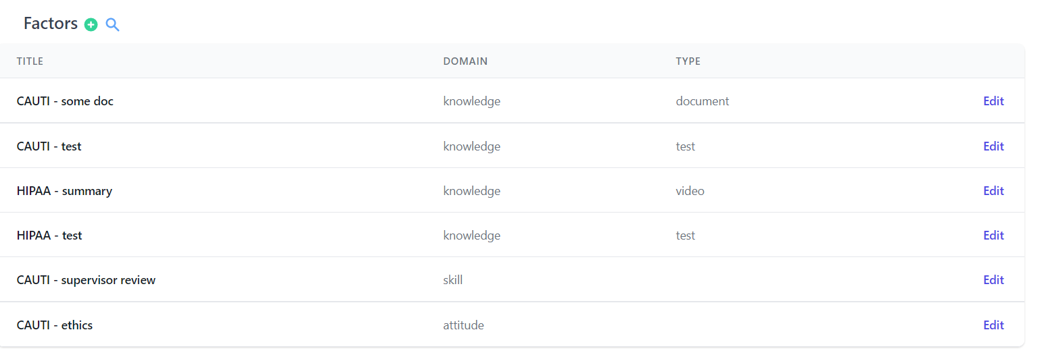
Organization - Learning domains (Knowledge, skill, attitude)

Slide 6
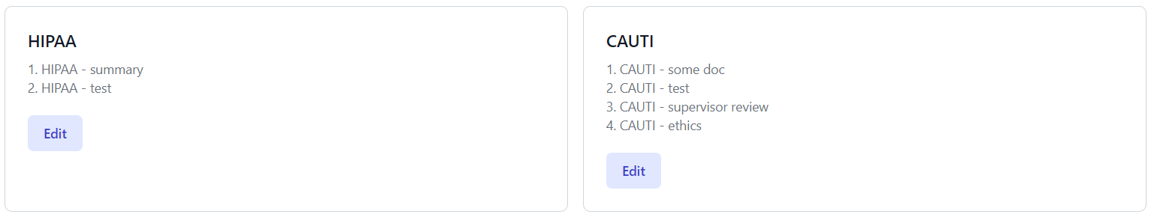
Organization - Competencies

Slide 7
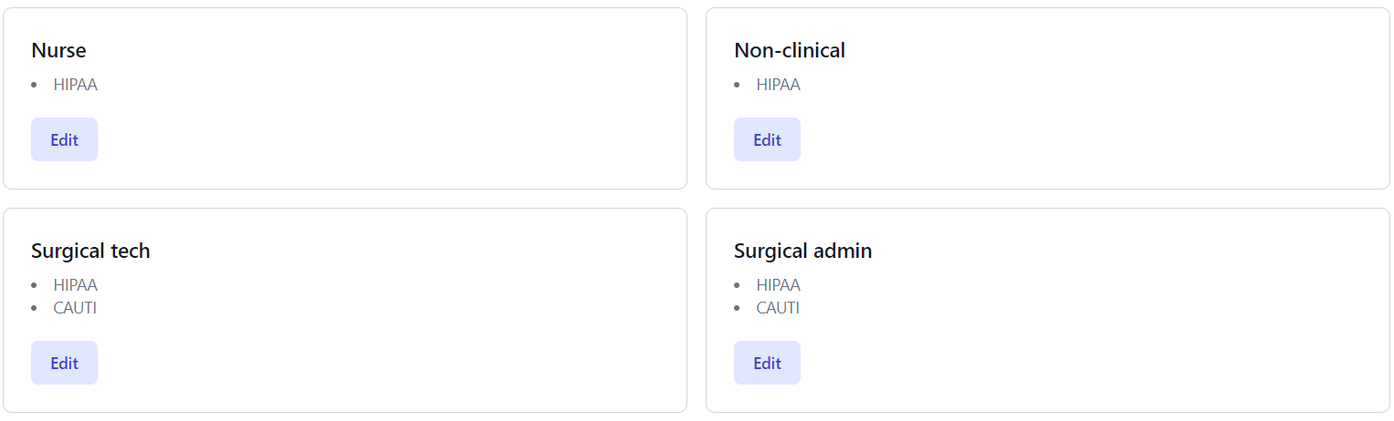
Organization - Roles

Slide 8
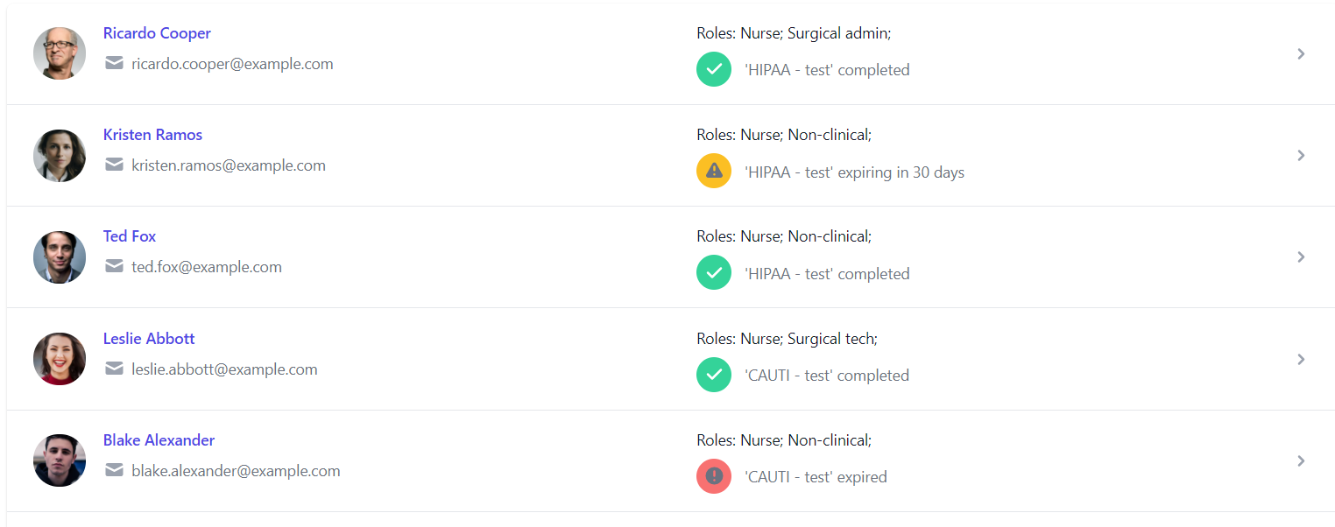
Organization - Users

Slide 9
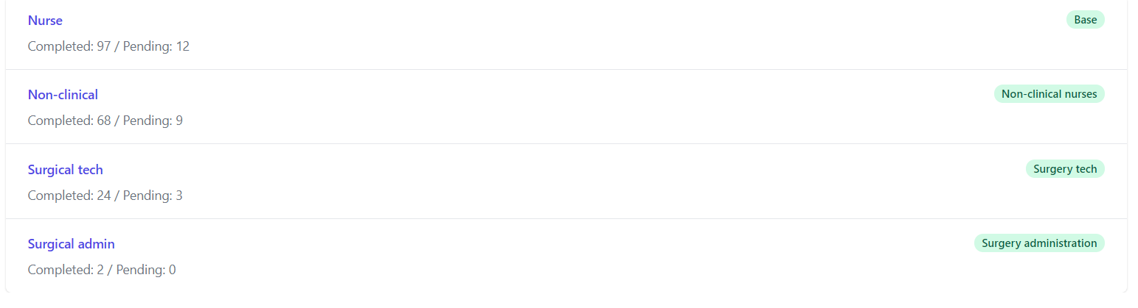
Organization - Overview

Slide 10
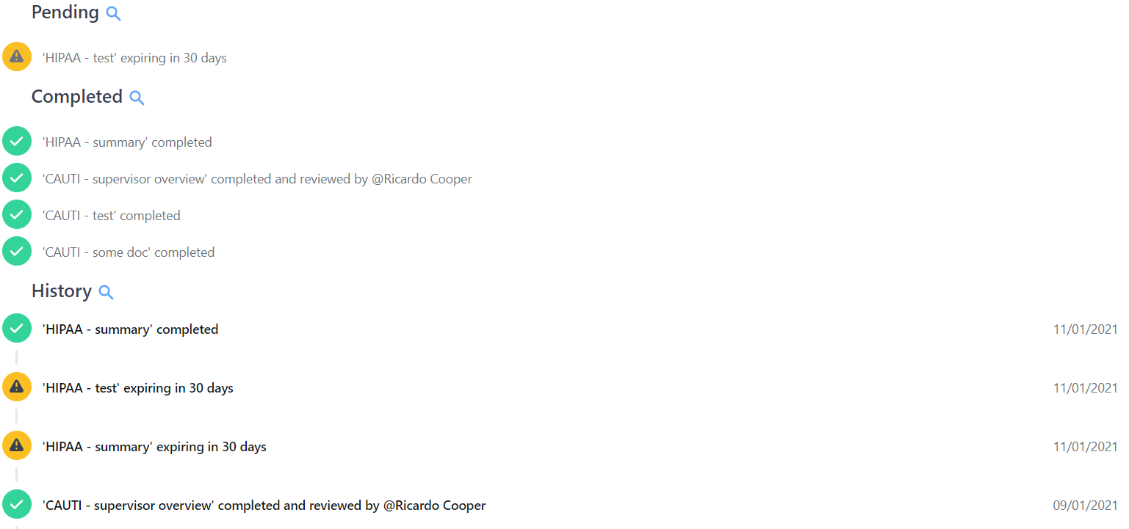
User - To do list

Slide 11
Our Solution vs. The Competition
Benefits | Our Solution | HealthStream LMS | Tine App | Lippincott
Accessible on all platforms (mobile, desktop, etc) | X |  | X
Business Intelligence Dashboard | X
Automated reminders | X | X
Contains all learning domains (Knowledge, Skill, Attitude) | X

Slide 12
Implementation Cost
Implementation costs
Technical (Developers and hosting)
Training (Educators and videos)
$50K within 6 months
Who's paying?
Organizations (i.e., hospitals, clinics, etc.)
Subscription based model (user / month)
Market penetration
Conferences (Nursing Magnet, etc)
Societies (AONL, AAAHC)
Consultants for NPD, AAAHC, TJC

Slide 13
Scalability & Future features
Use cases (anywhere compliance needs to be enforced)
New and existing employee orientation
Various settings (hospitals, clinics, etc.)
Future features
Public profiles
Job search
Path to success
Investment
Developers
Nurses
Marketing team

Slide 14

The Team
Mathew Monterola – Nurse Educator
Dinesh Antony – Software Developer

Slide 15
Q & A

Slide 16
Mobile app that houses all competency validation method
Assign competency
Competency Completion Dashboard
Risk Mitigation
Survey Ready

Slide 17

Name Lastname
Title
Write a short biography here…

Slide 18

Monterola, Mathew DNP, MSN, RN, PCCN-K mathew.monterola@cshs.org
Associate Director, Clinical Support Program
Cedars-Sinai Medical Center, Los Angeles, CA
Educator
Transformational Leader

Slide 19


Slide 20
Storytelling
You want to start with a story that draws people in and incapsulates why the topic is important to you
Storytelling allows us to talk WITH people, rather than just talk TO them, and allows us to create connections, People not only need to understand your idea, but they need to “feel” it.
The story should thread through the entire presentation: A good beginning, middle and end. At the close, wrap up your story.
The Set Up
The Struggle
The Solution
You may wish to get the storyline straight first using Post-its

Slide 21
Pitch Presentation Components
Problem Articulation
Your Solution (MVP)
Current Available Solutions
Implementation Cost
Scalability
The Team & Close
Questions

Slide 22
Problem Articulation- Begin Telling the Story
WHAT IS THE PROBLEM OR UNMET NEED YOU ARE SOLVING?
How you describe the problem is one of the most important components to a pitch. Tell us the problem through storytelling. Bring the audience straight into the story.
Talk about the problem that generated your idea, what motivated your project, and how it is part of your life and/or your group’s. This kind of information generates empathy and is the first step to grab their attention
Don’t assume we know anything, even if we are all nurses. Explain the problem in detail, step by step.
What is the problem/pain point you are trying to address? What does it cause? Who feels the pain point?
Engage and draw the audience in and make them feel like they are solving the problem with you.
HOW BIG IS THIS PROBLEM (Scope)? HOW MANY PEOPLE DOES IT AFFECT?
Data helps here if you can find the right information.
Example: if I am going to tell the audience about the problem with patient falls, I would want to let them know the volume of hospital falls with costs of $53 Billion dollars/year nationally.

Slide 23
Problem Articulation
Facts:
During the past year, hospital turnover increased by 1.7% and currently stands at 19.5%.
According to the survey, the average cost of turnover for a bedside RN is $40,038 and ranges from $28,400 to $51,700 resulting in the average hospital losing between $3.6m – $6.5m/yr.
The RN Recruitment Difficulty Index remains elevated at 89 days on average, regardless of specialty. In essence, it takes 3 months to recruit an experienced RN.
The RN vacancy rate continues to be of concern and currently stands at 9.9%
Given the economy and impact of COVID, RNs are no longer delaying retirement, and many have gone back to travel nursing, particularly given the lucrative contracts. During the pandemic, travel nurse packages reached $10,000/week
2021, the current turnover rate for acute care hospitals (19.5%). In Advanced pratice and allied health
Notes:
https://www.nsinursingsolutions.com/Documents/Library/NSI_National_Health_Care_Retention_Report.pdf

Slide 24
Currently Available Solutions
Current Solutions = Current Problems and/or Significant Inefficiencies?
You should research what is currently on the market to solve your problem. If there are solutions currently available, then make it clear what the issues are, so you can show how your solution differs and excels.
The current solutions will be your competitors, so knowing your competitive set well will enable you to better compete.
If no current solutions exist, make that clear.

Slide 25
Your Solution
Describe your proposed solution. Go in detail how your solution works and have a Minimally Viable Product (MVP) to demo
Convince the judges why your solution is superior. Simplify your story – what are the THREE things you want the audience to remember?
Speak to any regulations surrounding this solution or barriers you may encounter, but have a plan
Consider creating a grid to show what current solutions do and how your idea differs. This provides a very effective visual (see slides 11 and 12 for examples)

Slide 26
EXAMPLE 1 – Our Solution vs. The Competition
Benefits | Connect Nurse | Intelycare | Competitor 2 | Competitor 3 | Competitor 4
Intuitive to Use | X
Cost to Use | Free | $X Subscription
Platform | Microsoft | Zoom
Users | Patients/Families/Clinicians | Clinicians only

Slide 28
Implementation Cost
Although we don’t expect a full business plan, your team should think about implementation cost and who is going to pay for the solution.
Will it be the patient? Insurance Company? Hospital system etc.
Try to understand your costs to build your solution, which will in turn, inform you of what the costs will need to be.
How will you penetrate the market? Who are the key market influencers/decision makers that you need to target or consider?

Slide 29
Scalability
When devising a solution, you should always think about your target population and give it some thought as to how the solution can be scaled and implemented everywhere not just at your institution( this can happen later, of course, but be prepared to answer the question).
Are there other case uses for your solution?
What do you need to be successful?
Who else needs to be involved to implement your solution?

Slide 30
The Team & Close
Bring the story you opened with full circle.
Close the pitch– why do you think this is a great idea? Remind the audience what they have seen – no more than three points.
Introduce your team members and discuss skill sets brought to the team that strengthens the solution. By now the audience understands your proposed solution so they can connect the skill sets. Include contact Info: Name/Email
Many investors will invest if they like the team and find the team inspiring and passionate.
Try to anticipate the judges questions so you can answer them, however, if you have done your homework, you will be prepared.
Finally, practice, practice, practice! Getting all important points across in 3 minutes!

Slide 31
The Team
Jeanross
 | Zaibunissa Karim, RN,RM,MBA Assistant Manager Allied Health, Pakistan PACU Nurse with 12 yrs of experience
Notes:
This is our marvelous team members with diversify experience and regional background. There is a big gap in finding flexible job and delay recruiting time, connecting nurses stay at home, mothers, 55 above and baby Boomers who ar retire but still want to work and help the community through their skills and experience. Our solution will connect these nurses to health care system, like a uber or tinder for nurses.

Slide 32
Good Luck & Good Pitching!
– From NurseHack4Health Organizers

Slide 33
Slide Title in Arial Bold, 30 pt. Black
Subtitle in Arial Regular, 20 pt.
In some cases, the image will sit to the left of the text.
Make sure whichever you choose, it is consistent throughout your presentation.

Slide 34
Bar Chart Example
Extending past 6 colors
Manually select colors from palette to complete the chart.
When using bar charts, retain a minimum distance of 50% between data points.

Slide 35
Compare/Contrast Example
Subhead
Subhead
Your body copy goes here. Body copy goes here. Body copy goes here. Body copy goes here.
Your body copy goes here. Body copy goes here. Body copy goes here. Body copy goes here.
1 in 5
3 in 5
Describe your statistic here. This is where the text goes, in Arial 15pt font.
Describe your statistic here. This is where the text goes, in Arial15pt font.
22%
Subhead
31%
Subhead
Your content relating to the pie chart can go here.
Your first bullet point can go here.
This is where your second bullet point will go.
Your content relating to the pie chart can go here.
Your first bullet point can go here.
This is where your second bullet point will go.

Slide 36
Name Lastname
Title
Write a short biography here…

Slide 37
Timeline Overview
Phase 1 Description
Phase 2 Description
Phase 3 Description
Phase 4 Description
Deliverable 1 Additional info
Deliverable 2 Additional info
Deliverable 3 Additional info
Deliverable 4 Additional info

Slide 38
Venn Diagram
Topic 1
Topic 3
Topic 2
Text goes here
Text goes here
Text goes here
Text goes here
Text goes here
Text goes here
Text goes here
Text goes here
Text goes here

Slide 39


Organizational Chart
Name Lastname Title Description here…
Name Lastname Title Description here…
Name Lastname Title Description here…
Name Lastname Title Description here…
Name Lastname Title Description here…
Name Lastname Title Description here…
Name Lastname Title Description here…
Name Lastname Title Description here…
Name Lastname Title Description here…
Name Lastname Title Description here…
Name Lastname Title Description here…
Name Lastname Title Description here…
Name Lastname Title Description here…

Slide 40
Table Example A
Use solid colors headers and row color variations to separate information. Change table colors using the Table Design tab.
TOTAL COMPANY | 2010 | 2009 | % Change
 |  |  | TOTAL | OPS
Sales | $61.6B | $61.9B | (0.5%) | (1.3%)
Adjusted Earnings* | $13.3B | $12.9B | 2.9%
Adjusted EPS* | $4.76 | $4.63 | 2.8%
Free Cash Flow** | $14.0B | $14.2B

